Slide 1
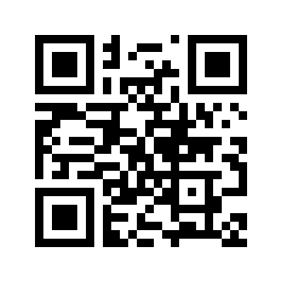
ACTUARIAL STUDIES AT ANU
  ANU College of Business and Economics
  Research School of Finance, Actuarial Studies and Statistics (RSFAS)
    Open up https://tinyurl.com/2bahjtmd on a web browser or use the QR code to the right to interact during this presentation!

Slide 2

What is an actuary?

Slide 3
From the Actuaries Institute of Australia
    “An actuary is a professional who uses mathematics, statistics, data and financial theory to assess and manage risk and opportunity. Actuaries analyse data to evaluate the financial and societal impact of future events, helping businesses and communities make sound decisions about the future.”

Slide 4
Where do Actuaries work?
 | Members | Primary % | Secondary %
General insurance | 1,807 | 31 | 45
Life insurance | 1,375 | 24 | 37
Data Science & AI | 443 | 8 | 35
Superannuation | 332 | 6 | 17
Investment | 273 | 5 | 21
Banking | 229 | 4 | 14
Health insurance | 187 | 3 | 15
Reinsurance | 171 | 3 | 18
Risk | 139 | 2 | 21
Finance | 101 | 2 | 16
Source: https://www.actuaries.asn.au/about-us/year-in-review-and-financial-statements

Slide 5

Who should consider an actuarial career?

Slide 6
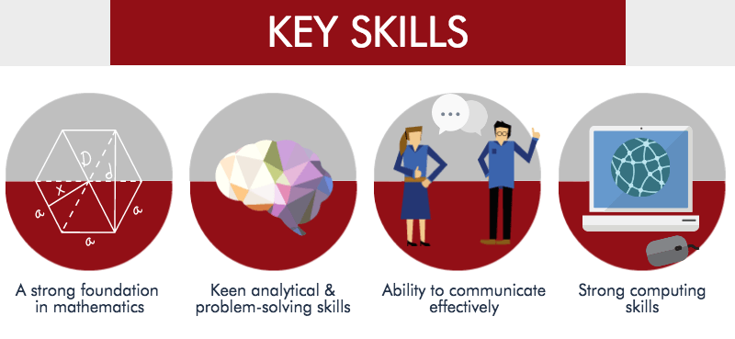
What skills are needed for an actuarial career?

Slide 7
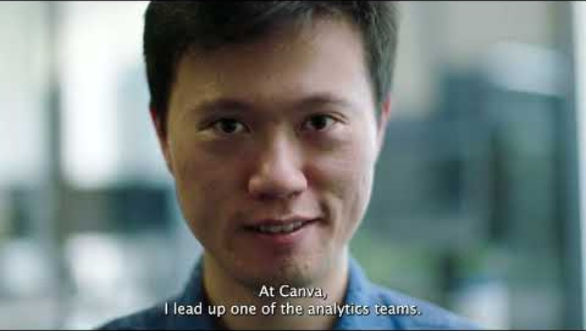
An example of actuarial work

Slide 8
Let’s get interactive!
Go to the following webpage and answer the questions:
https://tinyurl.com/2bahjtmd

Slide 9
A question of preferences
(1)
Suppose that:
You were given the choice of the following two options:
Someone gives you $100
You can have $250 if someone rolls a 4, 5 or 6 on a dice, but if they roll a 1, 2 or 3 you get nothing.

Slide 10
A question of preferences
(2)
Suppose that:
You were given the choice of the following two options:
Someone gives you $100,000
You can have $250,000 if someone rolls a 4, 5 or 6 on a dice, but if they roll a 1, 2 or 3 you get nothing.

Slide 11
Thinking of this in terms of insurance
Suppose that:
Your iPhone is really good, but sometimes breaks down and doesn’t work.
In any 12-month period, the chance that it breaks down is 5%.
If it costs $2,000 to replace or buy a new iPhone when it breaks – how much might you be willing to pay someone else to replace your phone, at no extra cost, if it broke down? $50? $300?
In other words – would you pay $2,050 (or $2,300) rather than $2,000 to protect yourself against the phone not working?
How much extra on top of $2,000 would you pay?

Slide 12
The Bachelor of Actuarial Studies at ANU
    Details can be found here.
    Entry requirements (2026):
      ATAR = 92
      Mathematics = Specialist (major, required) / Specialist (major/minor, recommended)
    ANU provides for potential exemption from the Foundation Program and half of the Actuary Program in Australia.
    Centre of Actuarial Excellence and opportunity for University Earned Credit with the Society of Actuaries.

Slide 13
Industry experts
    Our programs are designed with a primary goal to prepare you for the practical work of an actuary.
    Most of the actuarial staff have worked commercially before coming to academia – we know what is involved to prepare you for working life and future exams, and we prepare students for that.
    Feedback from employers about our graduates is excellent – ANU actuarial graduates are seen to be of a very high quality.

Slide 14
Australia’s National University
    #32 in the world¹
    #1 in Australia #15 in the world for most international university²
    #1 in Australia #30 in the world for graduate employability³
    6 Nobel Prize winners among our staff and alumni
    91% of academic staff hold a masters or doctoral degree, more than any other Australian university⁴
    5 star rating for student : teacher ratio⁴
    ¹ QS World University Rankings 2026
    ² Times Higher Education Most International University Rankings 2024
    ³ Times Higher Education Global University Employability Rankings 2025
    ⁴ Good Universities Guide 2024/2025

Slide 15

About CBE
  The ANU College of Business and Economics (CBE) exists to have a transformative impact on society through advancing knowledge in the fields of business and economics.
  The strength of our international reputation attracts exceptional students from Australia, the Asia-Pacific and beyond. We offer every student the opportunity to develop their strengths and the space to decide how they will make their future mark in the world.
    Four Research Schools
      Research School of Accounting
      Research School of Economics
      Research School of Finance, Actuarial Studies and Statistics
      Research School of Management
Our students
7,022
total number of students
3,111
postgraduate coursework students
3,781
undergraduate coursework students
130
Higher Degree Research students
(2025 ANU student data)
15

Slide 16

What can you study at CBE?
    Accounting (Top 50 in the world)*
    Actuarial Studies
    Business Analytics
    Business Information Systems (#37 in the world)*
    Commerce
    Corporate Sustainability
    Economics (#1 in Australia, #39 in the world)*
    Entrepreneurship
    Finance (Top 50 in the world)*
    International Business
    Management
    Marketing
    Project Management
    Statistics (#1 in Australia, #59 in the world)^
* QS World University Rankings by Subject 2025
^ Times Higher Education World University Rankings 2025 by Subject: Mathematics and Statistics
16

Slide 17

Real-World Skills
  CBE students and alumni have access to an innovative and engaged CBE Careers and Student Employability team to help them become job ready in the global market.
One-to-one services
    Career planning
    Job search strategies
    Resume review
    Job applications
    Interview preparation
    LinkedIn and networking.
Ranked #1 in Australia and #32 in the world for Graduate Employability
(Times Higher Education Global University Employability Rankings 2024)
Industry Engagement
    Internships
    Professional Development Programs
    Job fairs
    Industry-led workshops
    Employer presentations
    Mock assessment centres
    Work-integrated learning courses
    Alumni engagement
For more information on CBE Careers:
https://cbe.anu.edu.au/current-students/opportunities-and-careers/cbe-careers

Slide 18

Momentum
    Designed to enhance employability, career-readiness and support a successful transition to the workplace by developing confident, work-ready and competitive graduates.
    Developed and delivered in collaboration with industry partners.
    Interactive networking workshops, employability milestones and 1:1 time with an experienced industry mentor over a semester.
    Each interactive networking workshop focuses on a specific area of professional development and is designed sequentially to support student development around:
    Development around:
      Leadership
      Communication
      Critical thinking & problem-solving
      Personal brand
      Teamwork
    For more information:
    https://cbe.anu.edu.au/current-students/opportunities-and-careers/cbe-momentum

Slide 19

CBE Internship Program
    130 hours (6 units) or 260 hours (12 units)
    100+ local internship hosts in public, private, and for-purpose sectors.
    CBE-sourced or student-sourced projects
    Similar to real job applications.
    Key outcomes
      85% growth in employability skills
      90% student satisfaction
      50% nominated for Intern of the Year Awards
    For more information:
    https://cbe.anu.edu.au/current-students/opportunities-and-careers/cbe-internships
“
The experience taught me many valuable technical and professional skills. Most importantly, it allowed me to have exposure to a professional working environment and form lasting connections. An example of this is my internship supervisor, who I've kept in touch with over the years. It was through this connection that I found out about the opportunity to work in the role as Product Specialist, which subsequently led to my position as Technical Account Manager at Qualtrics.
Veeanna Lee
Bachelor of Actuarial Studies 2018
Senior Technical Success Manager, Qualtrics
”

Slide 20
Domestic - Applying to ANU – Semester 1 2027
Direct Applications open on 11 March 2026 and cover admission, scholarships and (where relevant) accommodation
Applications close on 8 May 2026
Early offers will be released on 3 September 2026
Early offer acceptance deadline is 30 September 2026
Change of academic preference period is 1 – 30 November 2026
Final offers released in late December 2026
Alternative approach is through the University Admissions Centre

Slide 21

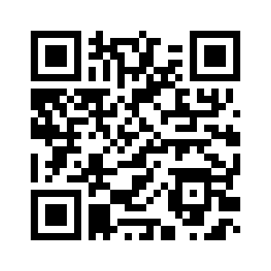
Would you like to know more?
ANU Open Day
Saturday 28 March
ANU Actuarial Studies Experience Day Wednesday 30 September
Register at:
https://cbe.anu.edu.au/actuarial-experience-day

